Slide 1

Basic Communication Operations
Parallel and Distributed Computing CS-3006

Slide 2
Introduction
In most parallel algorithms, processes need to exchange data with other processes.
This exchange of data can significantly impact the efficiency of parallel programs by introducing interaction delays during their execution.
Many interactions in practical parallel programs occur in well-defined patterns involving more than two processes.
Often either all processes participate together in a single global interaction operation, or subsets of processes participate in interactions local to each subset.
Proper implementation of these basic communication operations on various parallel architectures is a key to the efficient execution of the parallel algorithms that use them.

Slide 3
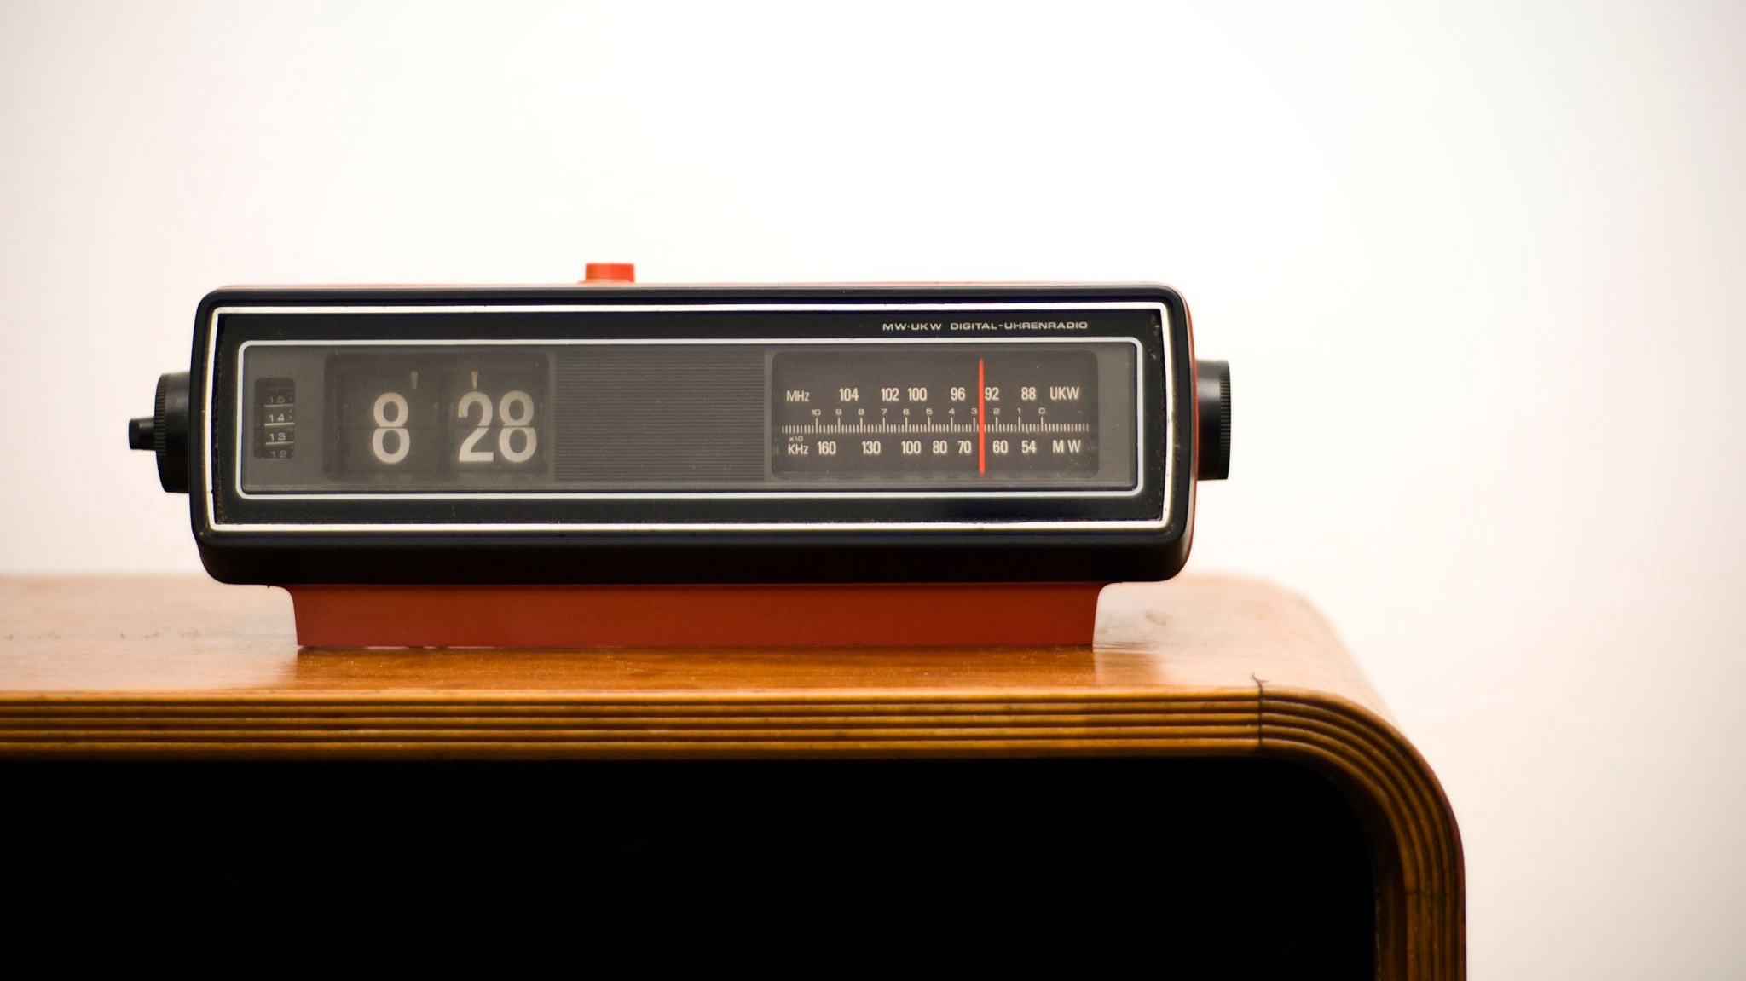
One-to-All Broadcast and All-to-One Reduction
Section 4.1

Slide 4
One-to-All Broadcast and All-to-One Reduction
Parallel algorithms often require a single process to send identical data to all other processes or to a subset of them.
This operation is known as one-to-all broadcast .
Initially, only the source process has the data of size m that needs to be broadcast.
At the termination of the procedure, there are p copies of the initial data – one belonging to each process.
The dual of one-to-all broadcast is all-to-one reduction .
In an all-to-one reduction operation, each of the p participating processes starts with a buffer M containing m words.
The data from all processes are combined through an associative operator and accumulated at a single destination process into one buffer of size m .
Reduction can be used to find the sum, product, maximum, or minimum of sets of numbers – the i th word of the accumulated M is the sum, product, maximum, or minimum of the i th words of each of the original buffers.

Slide 5
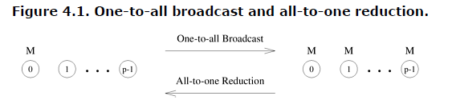
One-to-All Broadcast and All-to-One Reduction

Slide 6
Ring or Linear Array
A naive way to perform one-to-all broadcast is to sequentially send p - 1 messages from the source to the other p - 1 processes.
However, this is inefficient because the source process becomes a bottleneck.
Moreover, the communication network is underutilized because only the connection between a single pair of nodes is used at a time.
A better broadcast algorithm can be devised using a technique commonly known as recursive doubling .
The source process first sends the message to another process.
Now both these processes can simultaneously send the message to two other processes that are still waiting for the message.
By continuing this procedure until all the processes have received the data, the message can be broadcast in log p steps.

Slide 7
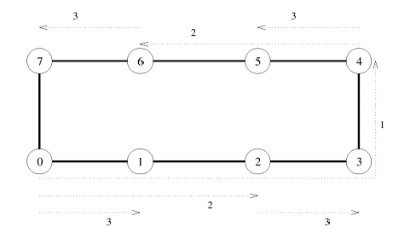
Ring or Linear Array
Notes:
One-to-all broadcast on an eight-node ring. Node 0 is the source of the broadcast.
Each message transfer step is shown by a numbered, dotted arrow from the source of the message to it destination.
The number on an arrow indicates the time step during which the message is transferred.

Slide 8
Ring or Linear Array- Things to remember
Note that on a linear array, the destination node to which the message is sent in each step must be carefully chosen.
In Figure (previous slide) , the message is first sent to the farthest node (4) from the source (0).
In the second step, the distance between the sending and receiving nodes is halved, and so on.
The message recipients are selected in this manner at each step to avoid congestion on the network.
For example, if node 0 sent the message to node 1 in the first step and then nodes 0 and 1 attempted to send messages to nodes 2 and 3, respectively, in the second step, the link between nodes 1 and 2 would be congested as it would be a part of the shortest route for both the messages in the second step.

Slide 9
Ring or Linear Array- Reduction
Reduction on a linear array can be performed by simply reversing the direction and the sequence of communication, as shown in Figure on the next slide .
In the first step, each odd numbered node sends its buffer to the even numbered node just before itself, where the contents of the two buffers are combined into one.
After the first step, there are four buffers left to be reduced on nodes 0, 2, 4, and 6, respectively.
In the second step, the contents of the buffers on nodes 0 and 2 are accumulated on node 0 and those on nodes 6 and 4 are accumulated on node 4.
Finally, node 4 sends its buffer to node 0, which computes the result of the reduction.

Slide 10
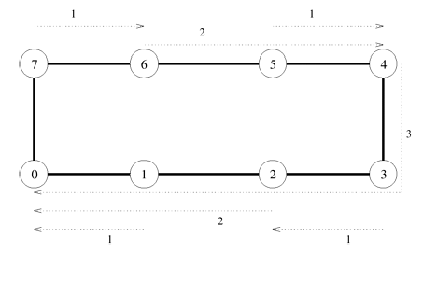
Ring or Linear Array- Reduction

Slide 11
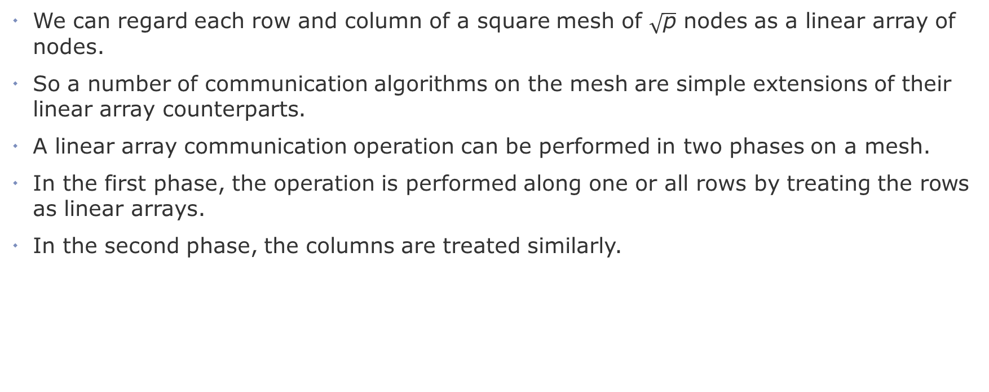
Mesh
We can regard each row and column of a square mesh of $\sqrt{\text{p}}$ nodes as a linear array of nodes.
So a number of communication algorithms on the mesh are simple extensions of their linear array counterparts.
A linear array communication operation can be performed in two phases on a mesh.
In the first phase, the operation is performed along one or all rows by treating the rows as linear arrays.
In the second phase, the columns are treated similarly.

Slide 12
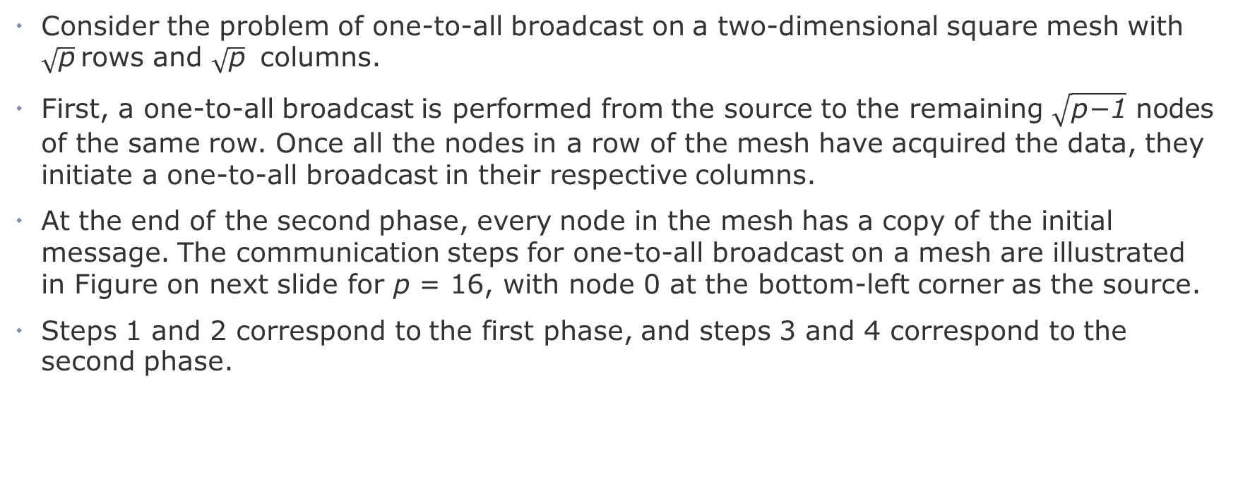
Mesh
Consider the problem of one-to-all broadcast on a two-dimensional square mesh with $\sqrt{\text{p}}$rows and $\sqrt{\text{p}}$ columns.
First, a one-to-all broadcast is performed from the source to the remaining $\sqrt{\text{p}\text{−1}}$ nodes of the same row. Once all the nodes in a row of the mesh have acquired the data, they initiate a one-to-all broadcast in their respective columns.
At the end of the second phase, every node in the mesh has a copy of the initial message. The communication steps for one-to-all broadcast on a mesh are illustrated in Figure on next slide for p = 16, with node 0 at the bottom-left corner as the source.
Steps 1 and 2 correspond to the first phase, and steps 3 and 4 correspond to the second phase.

Slide 13
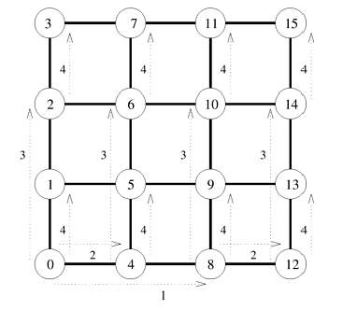
Mesh

Slide 14
Class Activity
Perform one to all broadcast on a three-dimensional mesh.

Slide 15
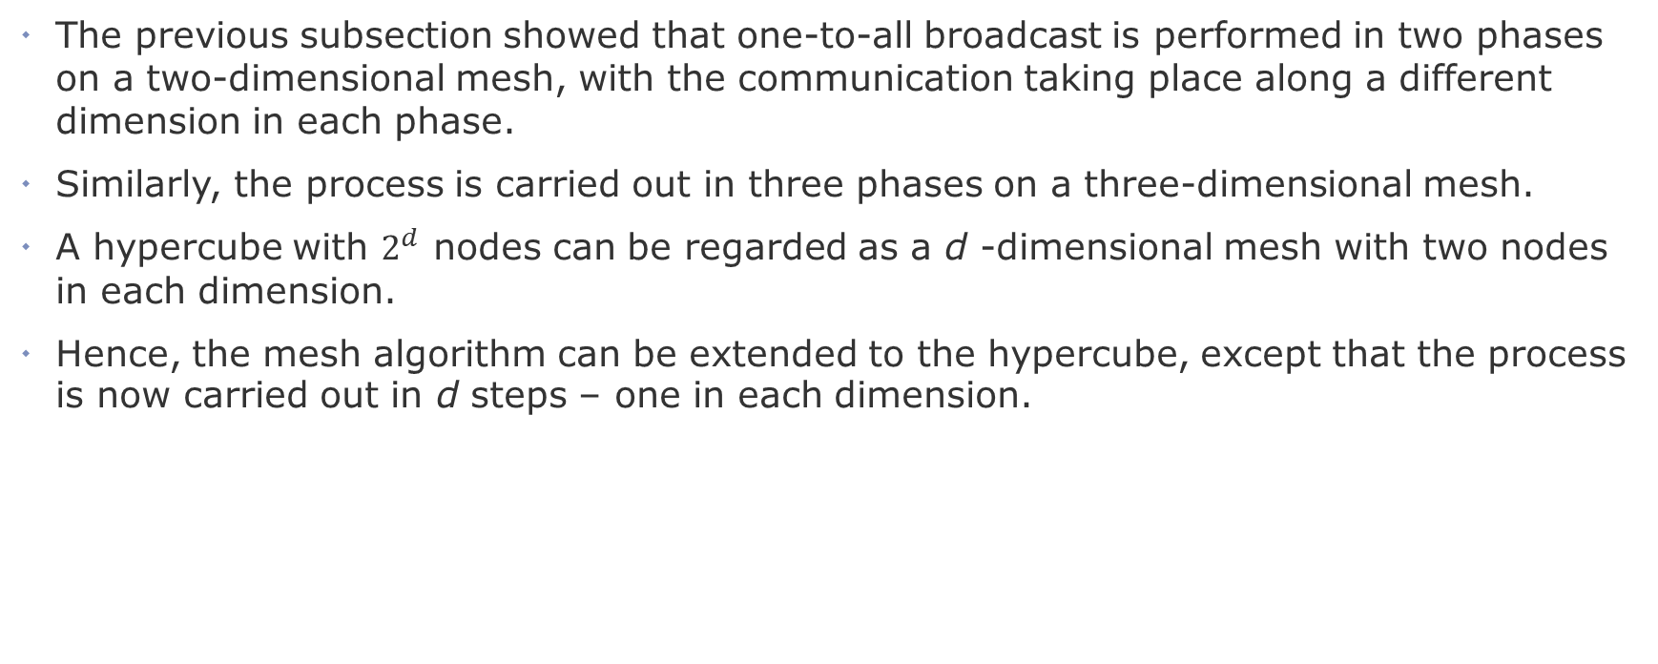
Hypercube
The previous subsection showed that one-to-all broadcast is performed in two phases on a two-dimensional mesh, with the communication taking place along a different dimension in each phase.
Similarly, the process is carried out in three phases on a three-dimensional mesh.
A hypercube with $2^{d}$ nodes can be regarded as a d -dimensional mesh with two nodes in each dimension.
Hence, the mesh algorithm can be extended to the hypercube, except that the process is now carried out in d steps – one in each dimension.

Slide 16
Hypercube
Figure on next slide shows a one-to-all broadcast on an eight-node (three-dimensional) hypercube with node 0 as the source.
In this figure, communication starts along the highest dimension (that is, the dimension specified by the most significant bit of the binary representation of a node label) and proceeds along successively lower dimensions in subsequent steps.
Unlike a linear array, the hypercube broadcast would not suffer from congestion if node 0 started out by sending the message to node 1 in the first step, followed by nodes 0 and 1 sending messages to nodes 2 and 3, respectively, and finally nodes 0, 1, 2, and 3 sending messages to nodes 4, 5, 6, and 7, respectively.

Slide 17
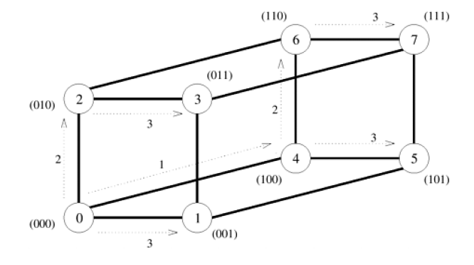
Hypercube

Slide 18
Balanced Binary Tree
The hypercube algorithm for one-to-all broadcast maps naturally onto a balanced binary tree in which each leaf is a processing node and intermediate nodes serve only as switching units.
This is illustrated in Figure on the next slide for eight nodes. In this figure, the communicating nodes have the same labels as in the hypercube algorithm illustrated before.
Figure shows that there is no congestion on any of the communication links at any time.
The difference between the communication on a hypercube and the tree shown in Figure on next slide is that there is a different number of switching nodes along different paths on the tree.

Slide 19
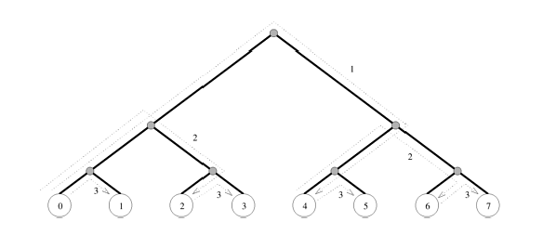
Balanced Binary Tree

Slide 20

All-to-All Broadcast and Reduction
Section 4.2

Slide 21
All-to-All Broadcast and Reduction
All-to-all broadcast is a generalization of one-to-all broadcast in which all p nodes simultaneously initiate a broadcast.
A process sends the same m-word message to every other process, but different processes may broadcast different messages.
All-to-all broadcast is used in matrix operations, including matrix multiplication and matrix-vector multiplication.
The dual of all-to-all broadcast is all-to-all reduction, in which every node is the destination of an all-to-one reduction

Slide 22
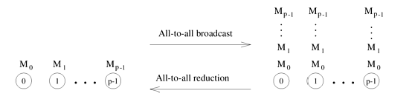
All-to-All Broadcast and Reduction

Slide 23
All-to-All Broadcast and Reduction
One way to perform an all-to-all broadcast is to perform p one-to-all broadcasts, one starting at each node.
If performed naively, on some architectures this approach may take up to p times as long as a one-to-all broadcast.
It is possible to use the communication links in the interconnection network more efficiently by performing all p one-to-all broadcasts simultaneously so that all messages traversing the same path at the same time are concatenated into a single message whose size is the sum of the sizes of individual messages.

Slide 24
Linear Array and Ring
While performing all-to-all broadcast on a linear array or a ring, all communication links can be kept busy simultaneously until the operation is complete because each node always has some information that it can pass along to its neighbor.
Each node first sends to one of its neighbors the data it needs to broadcast.
In subsequent steps, it forwards the data received from one of its neighbors to its other neighbor.

Slide 25
Linear Array and Ring
Figure in the next slides illustrates all-to-all broadcast for an eight-node ring.
The same procedure would also work on a linear array with bidirectional links.
As with the previous figures, the integer label of an arrow indicates the time step during which the message is sent.
In all-to-all broadcast, p different messages circulate in the p-node ensemble.
In the figure, each message is identified by its initial source, whose label appears in parentheses along with the time step.
For instance, the arc labeled 2 (7) between nodes 0 and 1 represents the data communicated in time step 2 that node 0 received from node 7 in the preceding step.
As the figure shows, if communication is performed circularly in a single direction, then each node receives all (p - 1) pieces of information from all other nodes in (p - 1) steps.

Slide 26
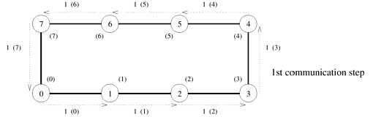
Linear Array and Ring 1st communication step

Slide 27
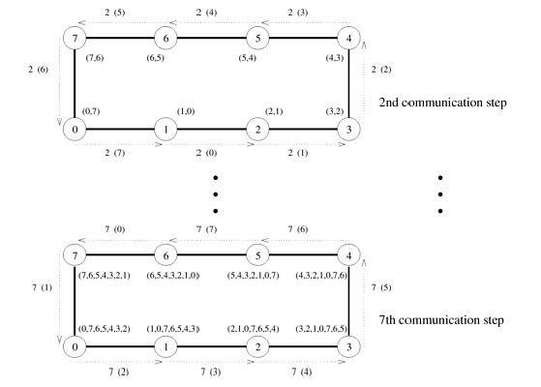
Linear Array and Ring 2nd to nth communication step

Slide 28
Linear Array and Ring
In all-to-all reduction, the dual of all-to-all broadcast, each node starts with p messages, each one destined to be accumulated at a distinct node.
All-to-all reduction can be performed by reversing the direction and sequence of the messages.
For example, the first communication step for all-to-all reduction on an 8-node ring would correspond to the last step of Figure in the previous slides, with node 0 sending msg[1] to 7 instead of receiving it.
The only additional step required is that upon receiving a message, a node must combine it with the local copy of the message that has the same destination as the received message before forwarding the combined message to the next neighbor

Slide 29
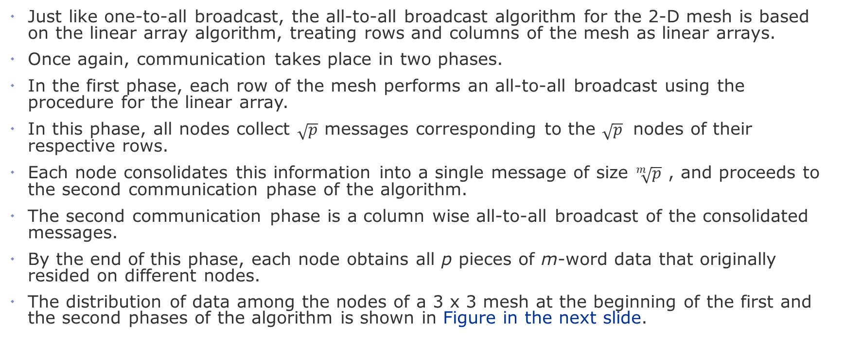
Mesh
Just like one-to-all broadcast, the all-to-all broadcast algorithm for the 2-D mesh is based on the linear array algorithm, treating rows and columns of the mesh as linear arrays.
Once again, communication takes place in two phases.
In the first phase, each row of the mesh performs an all-to-all broadcast using the procedure for the linear array.
In this phase, all nodes collect $\sqrt{p}$ messages corresponding to the $\sqrt{p}$ nodes of their respective rows.
Each node consolidates this information into a single message of size $\sqrt[m]{p}$ , and proceeds to the second communication phase of the algorithm.
The second communication phase is a column wise all-to-all broadcast of the consolidated messages.
By the end of this phase, each node obtains all p pieces of m-word data that originally resided on different nodes.
The distribution of data among the nodes of a 3 x 3 mesh at the beginning of the first and the second phases of the algorithm is shown in Figure in the next slide.

Slide 30
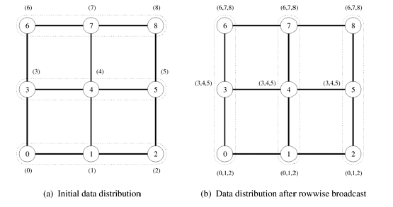
Mesh

Slide 31
Hypercube
The hypercube algorithm for all-to-all broadcast is an extension of the mesh algorithm to log p dimensions.
The procedure requires log p steps.
Communication takes place along a different dimension of the p-node hypercube in each step.
In every step, pairs of nodes exchange their data and double the size of the message to be transmitted in the next step by concatenating the received message with their current data.
Figure in the next slide shows these steps for an eight-node hypercube with bidirectional communication channels.

Slide 32
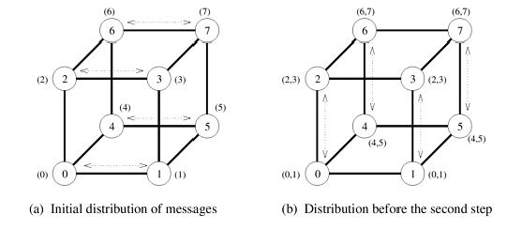
Hypercube

Slide 33
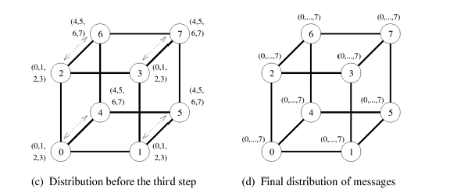
Hypercube

Slide 34

All-Reduce
Section 4.3

Slide 35
All-Reduce
The communication pattern of all-to-all broadcast can be used to perform some other operations as well.
One of these operations is a third variation of reduction, in which each node starts with a buffer of size m and the final results of the operation are identical buffers of size m on each node that are formed by combining the original p buffers using an associative operator.
Semantically, this operation, often referred to as the all-reduce operation, is identical to performing an all-to-one reduction followed by a one-to-all broadcast of the result.
This operation is different from all-to-all reduction, in which p simultaneous all-to-one reductions take place, each with a different destination for the result

Slide 36
All-Reduce
A simple method to perform all-reduce is to perform an all-to-one reduction followed by a one- to- all broadcast.
However, there is a faster way to perform all-reduce by using the communication pattern of all-to-all broadcast.
Figure in the next slide illustrates this algorithm for an eight-node hypercube.
Assume that each integer in parentheses in the figure, instead of denoting a message, denotes a number to be added that originally resided at the node with that integer label.
To perform reduction, we follow the communication steps of the all-to-all broadcast procedure, but at the end of each step, add two numbers instead of concatenating two messages.
At the termination of the reduction procedure, each node holds the sum (0 + 1 + 2 + ··· + 7) (rather than eight messages numbered from 0 to 7, as in the case of all-to-all broadcast).
Unlike all-to-all broadcast, each message transferred in the reduction operation has only one word.
The size of the messages does not double in each step because the numbers are added instead of being concatenated.

Slide 37
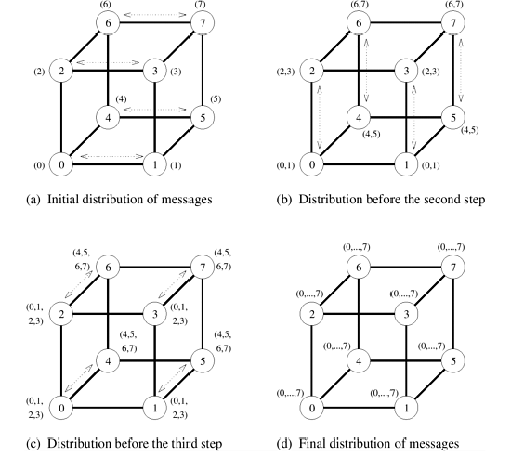
All-Reduce
Notes:
Machine learning (distributed training): Combining gradients from multiple GPUs.
Scientific computing: Summing results across multiple processors.

Slide 38
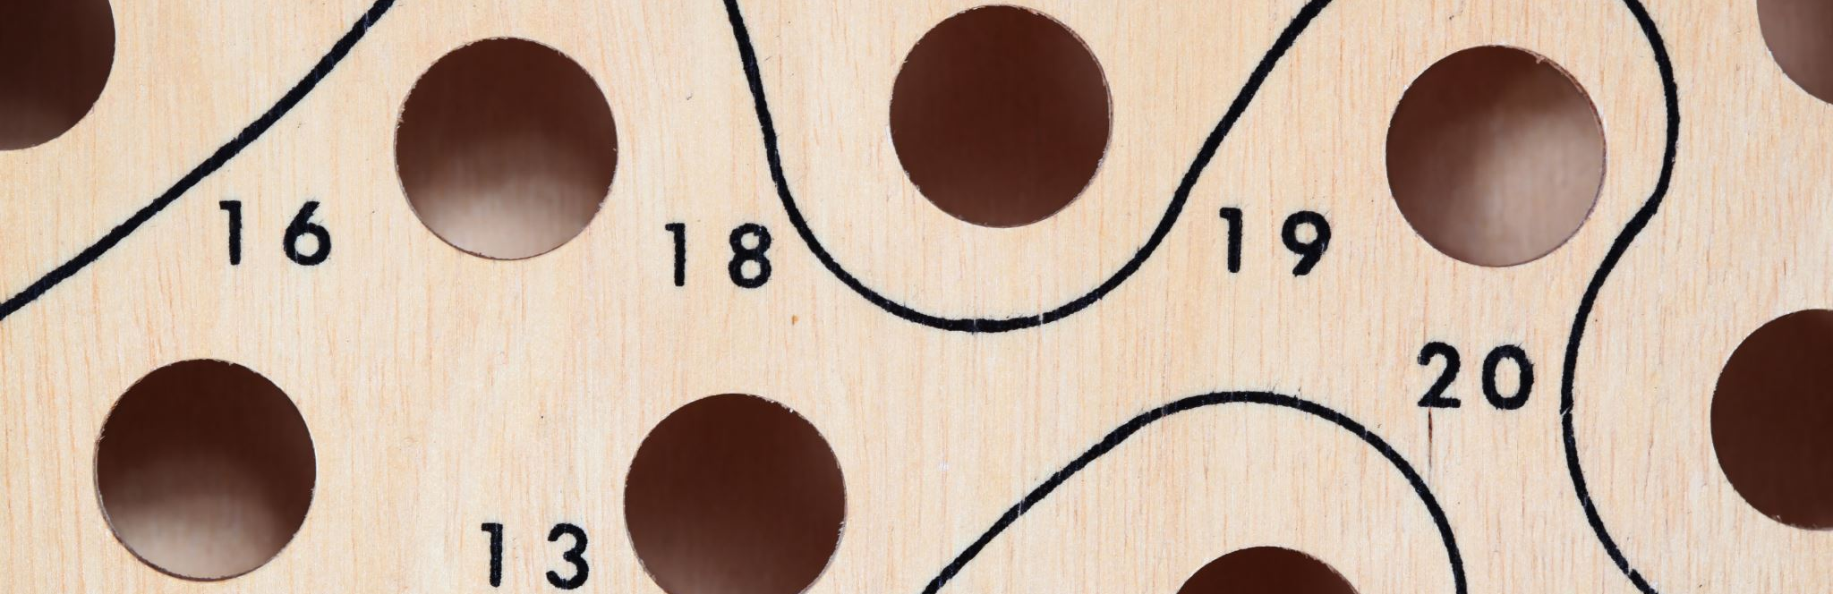
Scatter and Gather
Section 4.4

Slide 39
Scatter and Gather
In the scatter operation, a single node sends a unique message of size m to every other node.
This operation is also known as one-to-all personalized communication.
One-to-all personalized communication is different from one-to-all broadcast in that the source node starts with p unique messages, one destined for each node.
Unlike one-to-all broadcast, one-to-all personalized communication does not involve any duplication of data.
The dual of one-to-all personalized communication or the scatter operation is the gather operation, or concatenation, in which a single node collects a unique message from each node.
A gather operation is different from an all-to-one reduce operation in that it does not involve any combination or reduction of data.

Slide 40
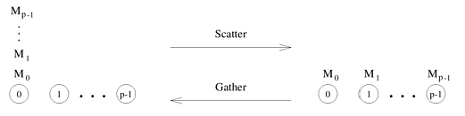
Scatter and Gather

Slide 41
Scatter and Gather
Although the scatter operation is semantically different from one-to-all broadcast, the scatter algorithm is quite similar to that of the broadcast.
Figure in the next slide shows the communication steps for the scatter operation on an eight-node hypercube.
The communication patterns of one-to-all broadcast (Figure shown previously) and scatter (Figure in next slide) are identical.
Only the size and the contents of messages are different.
In the figure on the next slide, the source node (node 0) contains all the messages.
The messages are identified by the labels of their destination nodes.
In the first communication step, the source transfers half of the messages to one of its neighbors.
In subsequent steps, each node that has some data transfers half of it to a neighbor that has yet to receive any data.
There is a total of log p communication steps corresponding to the log p dimensions of the hypercube.

Slide 42
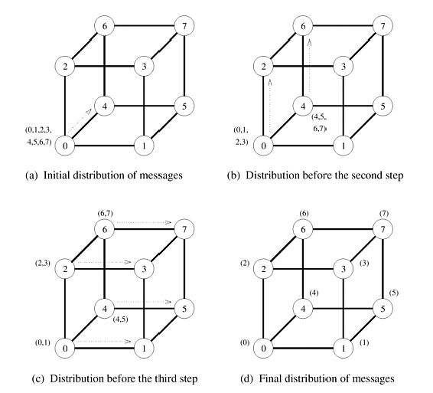
Scatter on 8 node hypercube
Notes:
Distributed Machine Learning Scatter: Distributes parts of a dataset to different nodes. Gather: Collects results after computation.
Parallel Computing Scatter: Splits workloads among nodes. Gather: Collects outputs for final processing.

Slide 43
Scatter and Gather
The gather operation is simply the reverse of scatter.
Each node starts with an m word message.
In the first step, every odd numbered node sends its buffer to an even numbered neighbor behind it, which concatenates the received message with its own buffer.
Only the even numbered nodes participate in the next communication step which results in nodes with multiples of four labels gathering more data and doubling the sizes of their data.
The process continues similarly, until node 0 has gathered the entire data.
Just like one-to-all broadcast and all-to-one reduction, the hypercube algorithms for scatter and gather can be applied unaltered to linear array and mesh interconnection topologies without any increase in the communication time.

Slide 44

All-to-All Personalized Communication
Section 4.5

Slide 45
All-to-All Personalized Communication
In all-to-all personalized communication, each node sends a distinct message of size m to every other node.
Each node sends different messages to different nodes, unlike all-to-all broadcast, in which each node sends the same message to all other nodes.
Figure on the next slide illustrates the all-to-all personalized communication operation.
All - to- all personalized communication is also known as total exchange.
This operation is used in a variety of parallel algorithms such as fast Fourier transform, matrix transpose, sample sort, and some parallel database join operations.

Slide 46
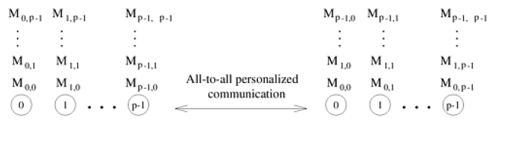
All-to-All Personalized Communication

Slide 47
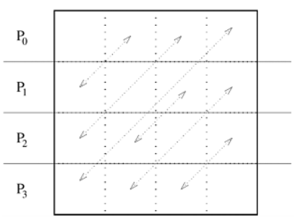
All-to-All Personalized Communication
Matrix transposition

Slide 48
All-to-All Personalized Communication-Ring
Figure in the next slide shows the steps in an all-to-all personalized communication on a six-node linear array.
To perform this operation, every node sends p - 1 pieces of data, each of size m.
In the figure, these pieces of data are identified by pairs of integers of the form {i, j}, where i is the source of the message and j is its final destination.
First, each node sends all pieces of data as one consolidated message of size m(p - 1) to one of its neighbors (all nodes communicate in the same direction).
Of the m(p - 1) words of data received by a node in this step, one m-word packet belongs to it.

Slide 49
All-to-All Personalized Communication-Ring
Therefore, each node extracts the information meant for it from the data received and forwards the remaining (p - 2) pieces of size m each to the next node.
This process continues for p - 1 steps.
The total size of data being transferred between nodes decreases by m words in each successive step.
In every step, each node adds to its collection one m-word packet originating from a different node.
Hence, in p - 1 steps, every node receives the information from all other nodes in the ensemble.

Slide 50
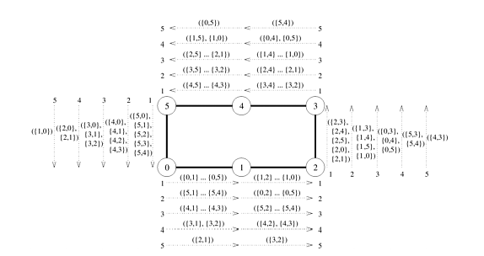
All-to-All Personalized Communication-Ring

Slide 51
All-to-All Personalized Communication-Ring
Scenario:
You have a parallel computing system with 6 nodes (labeled 0, 1, 2, 3, 4, and 5).
Each node needs to send a personalized message to all other nodes in the system. For example, Node 0 sends messages to nodes 1, 2, 3, 4, and 5, Node 1 sends messages to nodes 0, 2, 3, 4, and 5, and so on.
The time to send data between any two nodes (ts) is 0.1 seconds.
The time to process the data at each receiving node (tw) is 0.05 seconds.
The size of the data being communicated (m) is 2 MB.
You want to estimate the total runtime (t) for this personalized all-to-all communication.
Total communication pairs (p) = 6 nodes * 5 communication pairs/node = 30 pairs.
1 megabyte (MB) is equal to 8 megabits (Mb) so 2MB=16Mb
t = (0.1 + 0.05 * 16 * 30/2) * (30 - 1)
Cost Analysis
t = (ts + tw * m * p/2) * (p - 1)

Slide 52
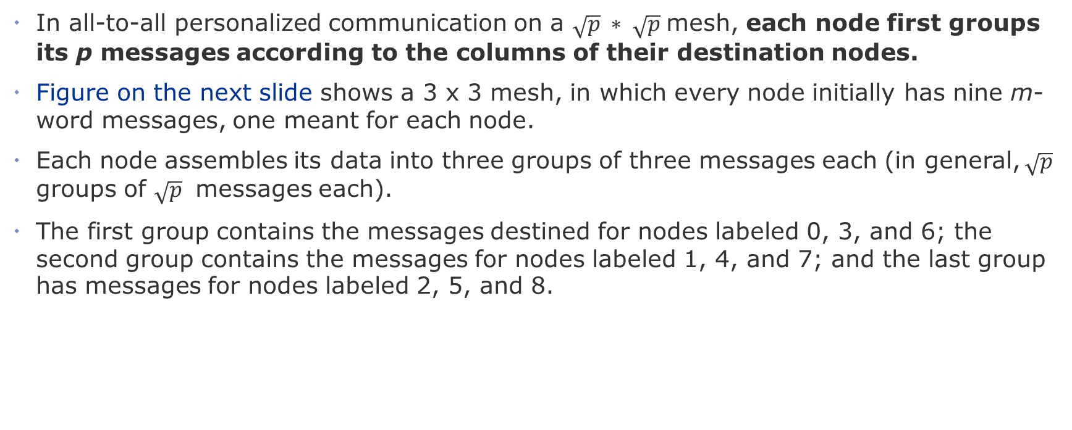
All-to-All Personalized Communication-Mesh
In all-to-all personalized communication on a $\sqrt{p} ∗ \sqrt{p}$mesh, each node first groups its p messages according to the columns of their destination nodes.
Figure on the next slide shows a 3 x 3 mesh, in which every node initially has nine m-word messages, one meant for each node.
Each node assembles its data into three groups of three messages each (in general, $\sqrt{p}$ groups of $\sqrt{p}$ messages each).
The first group contains the messages destined for nodes labeled 0, 3, and 6; the second group contains the messages for nodes labeled 1, 4, and 7; and the last group has messages for nodes labeled 2, 5, and 8.

Slide 53
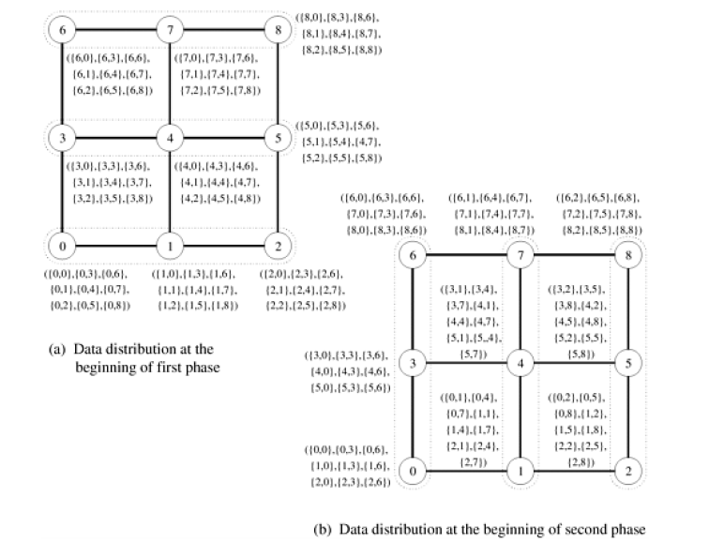
All-to-All Personalized Communication-Mesh

Slide 54
All-to-All Personalized Communication-Mesh
After the messages are grouped, all-to-all personalized communication is performed independently in each row with clustered messages of size .
One cluster contains the information for all nodes of a particular column.
Figure b on the previous slide shows the distribution of data among the nodes at the end of this phase of communication.
Before the second communication phase, the messages in each node are sorted again, this time according to the rows of their destination nodes; then communication similar to the first phase takes place in all the columns of the mesh.
By the end of this phase, each node receives a message from every other node.

Slide 55
All-to-All Personalized Communication-Hypercube
One way of performing all-to-all personalized communication on a p-node hypercube is to simply extend the two-dimensional mesh algorithm to log p dimensions.
Figure on the next slide shows the communication steps required to perform this operation on a three-dimensional hypercube.
As shown in the figure, communication takes place in log p steps.
Pairs of nodes exchange data in a different dimension in each step.
At any stage in all-to- all personalized communication, every node holds p packets of size m each.
While communicating in a particular dimension, every node sends p/2 of these packets (consolidated as one message).
The destinations of these packets are the nodes of the other subcube connected by the links in current dimension.

Slide 56
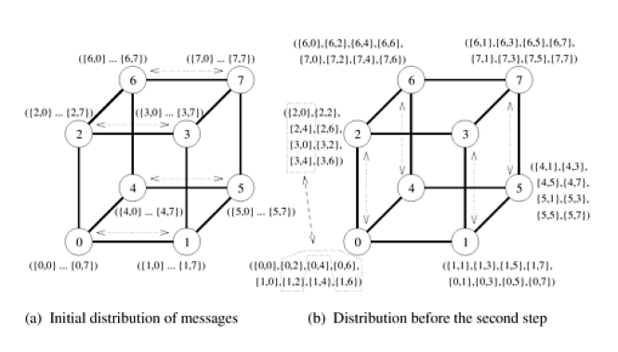
All-to-All Personalized Communication-Hypercube

Slide 57
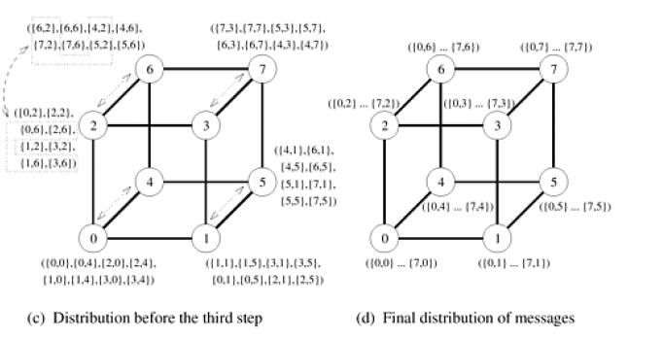
All-to-All Personalized Communication-Hypercube

Slide 58
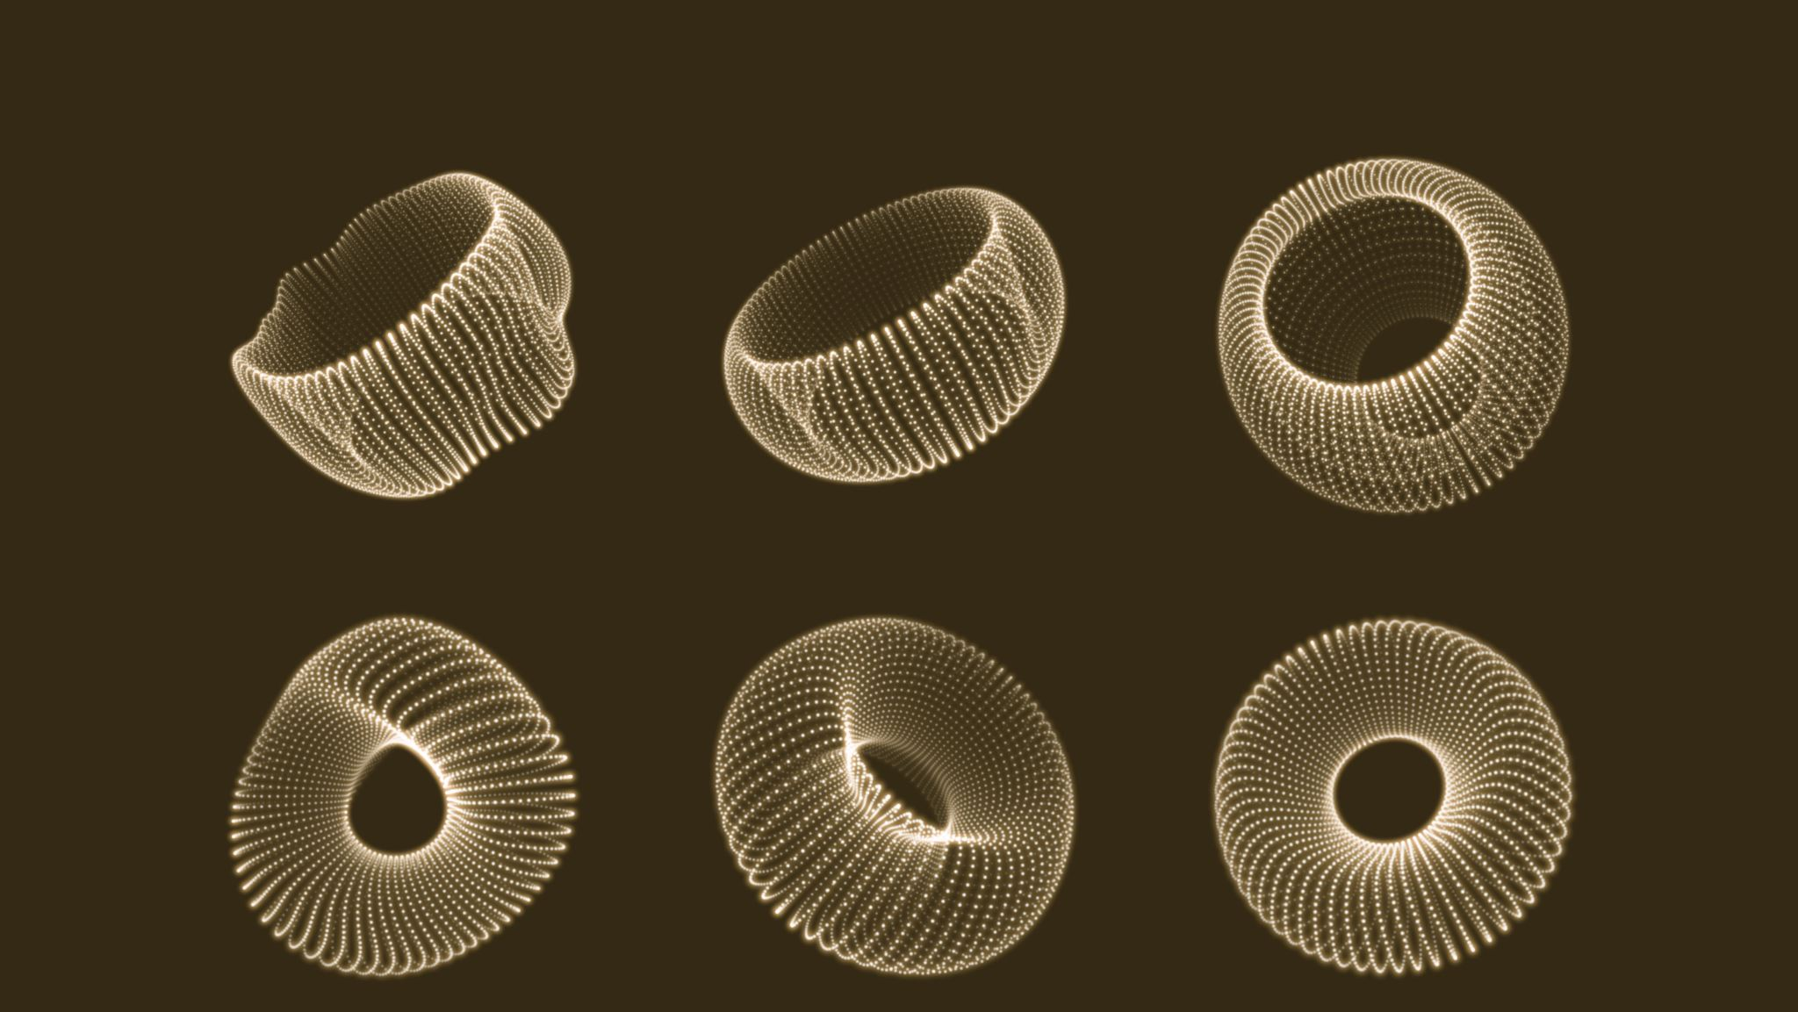
Circular Shift
Section 4.6

Slide 59
Circular Shift
Circular shift is a member of a broader class of global communication operations known as permutation.
A permutation is a simultaneous, one-to-one data redistribution operation in which each node sends a packet of m words to a unique node.
We define a circular q-shift as the operation in which node i sends a data packet to node (i + q) mod p in a p-node ensemble (0 < q < p).
The shift operation finds application in some matrix computations and in string and image pattern matching.

Slide 60
Circular Shift - Mesh
The implementation of a circular q-shift is fairly intuitive on a ring or a bidirectional linear array.
It can be performed by min{q , p - q} neighbor-to-neighbor communications in one direction.
Mesh algorithms for circular shift can be derived by using the ring algorithm.
If the nodes of the mesh have row-major labels, a circular q-shift can be performed on a p-node square wraparound mesh in two stages.
This is illustrated in Figure on the next slide for a circular 5-shift on a 4 x 4 mesh.

Slide 61
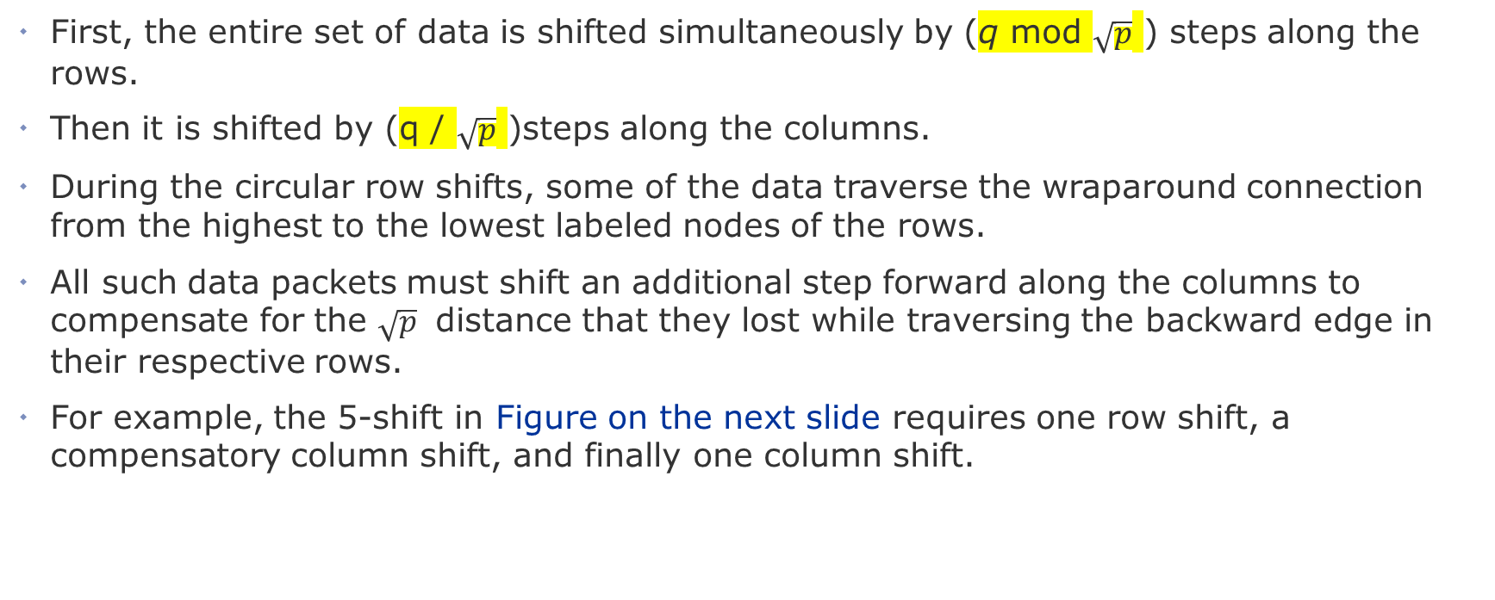
Circular Shift - Mesh
First, the entire set of data is shifted simultaneously by (q mod $\sqrt{p}$ ) steps along the rows.
Then it is shifted by (q / $\sqrt{p}$ )steps along the columns.
During the circular row shifts, some of the data traverse the wraparound connection from the highest to the lowest labeled nodes of the rows.
All such data packets must shift an additional step forward along the columns to compensate for the $\sqrt{p}$ distance that they lost while traversing the backward edge in their respective rows.
For example, the 5-shift in Figure on the next slide requires one row shift, a compensatory column shift, and finally one column shift.

Slide 62
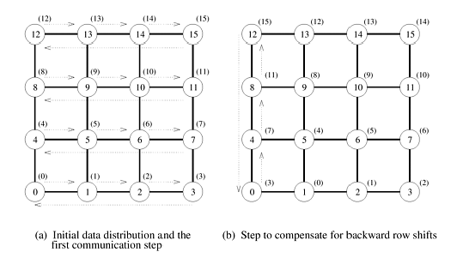
Circular Shift - Mesh
5-Shift
1. Row
Q mod sqrt(5)
5 mod sqrt(16)=1
After every row shift we have one compensatory column shift
2. Column
Floor(q/sqrt(p))
Floor(5/sqrt(16))=1

Slide 63
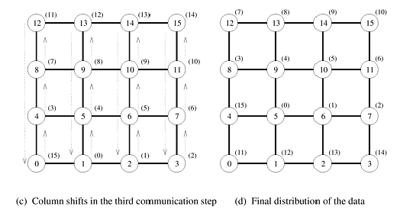
Circular Shift - Mesh

Slide 64
Circular Shift - Hypercube
In developing a hypercube algorithm for the shift operation, we map a linear array with 2^d nodes onto a d-dimensional hypercube.
We do this by assigning node i of the linear array to node j of the hypercube such that j is the d-bit binary reflected Gray code (RGC) of i.
Figure on the next slide illustrates this mapping for eight nodes.
A property of this mapping is that any two nodes at a distance of 2i on the linear array are separated by exactly two links on the hypercube.
An exception is i = 0 (that is, directly-connected nodes on the linear array) when only one hypercube link separates the two nodes.

Slide 65
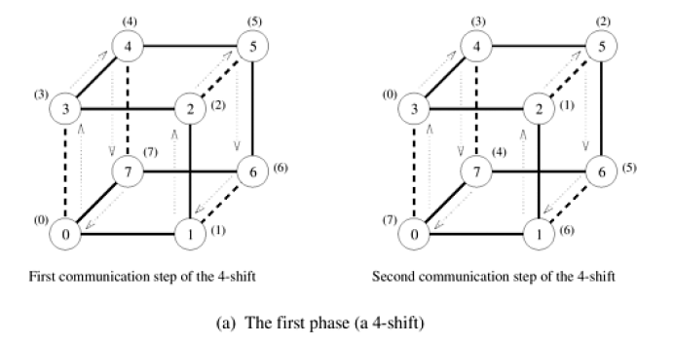
Circular Shift - Hypercube
There are some dotted lines and some dark line. Dark lines is linear array.
Dotted lines are indirect link to facilitate communication in hypercube. For example 0 wanted to send data to 3. In linear array 0->1->2->3 but in indirect link directly 0->3.

Slide 66
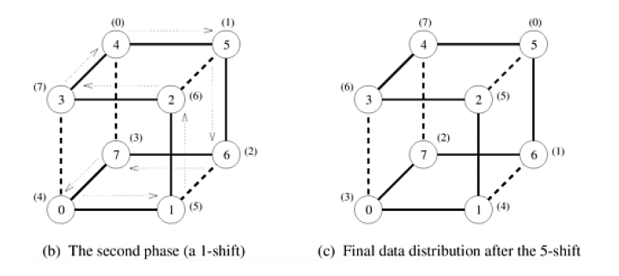
Circular Shift - Hypercube

Slide 67
Thank you ☺

